Slide 1
Accessibility for Content Developer, Designer, Web Developer and Tester
Make differently abled to digitally enabled
Part 1 of 2

Slide 2
Agenda
What is Accessibility ?
Accessibility Statistics
Examples of Accessibility
Types of Disabilities
Assistive Technologies
Accessibility Compliance Laws
Case Studies of Accessibilities
Need for Compliance
Accessibility Principles
Conformance Level
Accessibility for Content Developer
Accessibility for Designer
Accessibility for Code Developer
Accessibility for Tester

Slide 3
What is Accessibility ?
Accessibility in the sense considered here refers to the design of products, devices, services, or environments so as to be usable by people with disabilities
Accessibility is strongly related to universal design which is the process of creating products that are usable by people with the widest possible range of abilities, operating within the widest possible range of situations
Accessibility can be viewed as the "ability to access" and benefit from some system
Accessibility can be implemented in software’s, houses, malls, roads, transportation, in daily use objects

Slide 4
Accessibility Statistics
About 15% of the world's population lives with some form of disability, of whom 2-4% experience significant difficulties in functioning
The number of people with disabilities is growing. This is because populations are ageing – older people have a higher risk of disability. Aging and Disability are linked
785 million (15.6%) persons 15 years and older live with a disability

Slide 5
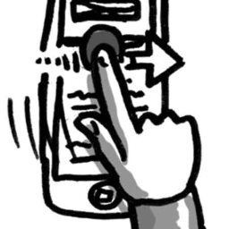

Examples of Accessibility
Mobile, Tablets, Web applications are made accessible to reach disable community (Universal and Inclusive Design)
The ridges found on the F and J buttons on a computer keyboard are designed to help users locate the correct keys (Universal and Inclusive Design)

Slide 6
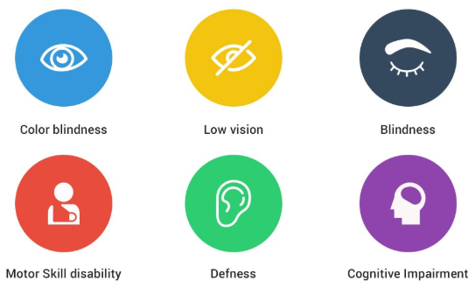
Types of Disabilities

Slide 7





Screen Readers
JAWS
Windows Eye
NVDA
Voice Over
Talkback

Slide 8

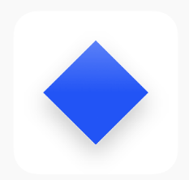




Open Source Plugins
WAVE
Color Contrast Analyser
Web Accessibility Toolbar
Google Light House
Acc Checker

Slide 9

Accessibility Compliance Law
Canadian Human Rights Act
AODA
European Union: EN 301 549:
ADA
US Section 508
UK-Equality Act
China – Law of Protection for PWD
India – National Policy for PWD
Singapore – Enabling Masterplan
Australia – Disability Discrimination Act

Slide 10
Case Studies of Accessibility
Tesco Access Site - 35 thousand pounds to build, 13 million pounds a year in resultant revenue (2004, UK)
Legal & General - achieved 50% more natural search visitors and many more conversions after accessibility improvements (2007, UK)
CNET - Reported 30% increase in CNET traffic from Google after they started providing transcripts. We saw a significant increase in SEO referrals when we launched an HTML version of our site, the major component of which was our transcripts. - Justin Eckhouse, CNET, 2009
Sydney Olympic Games - required to pay 20 thousand dollars in damages due to poor accessibility (2000, Australia)
Target Corporation - paid 6 million dollars in damages after action by US National Federation for the Blind (2008, USA)
Amex - America Express hit the headlines after excluding visually impaired customers due to making its statements less accessible in a format change (2008, UK)

Slide 11
Need for Compliance
WCAG Publish Timelines
1999 - WCAG 1.0
2008 - WCAG 2.0 (testable statements and were technology agnostic)
2012 - WCAG 2.0 became ISO standard, ISO/IEC 40500:2012
Eventually adopted across industry, government and many private organizations.
Need for WCAG 2.1
Technology is continuously evolving
Moved from brick mobile to touch screen smart phones.
New modalities - Gesture based, voice-controls, multi-touch interfaces.
WCAG 2.0 covers wide range of users with multiple disabilities, But the needs of users with low-vision and cognitive impairment weren't fully accommodated in WCAG 2.0.
June 2018 – WCAG 2.1
WCAG 2.1 new guideline and success criteria focus three major groups:
users with cognitive or learning disabilities,
Speech recognition
users with low vision,
users with disabilities on mobile devices

Slide 12
Conformance Level
There are three levels of conformance:
Level A: Must be satisfied otherwise one or more group will find access to content impossible. It’s the basic requirement.
Level AA: Should be satisfied otherwise one or more group will find access to content difficult. Removes significant barriers.
Level AAA: May be satisfied otherwise one or more group will find access to content somewhat difficult. Improves accessibility.
There are four accessibility principles in WCAG 2.1
There are a total of 12 Guidelines
Each Guideline has some Success Criteria that are at either level of conformance. Total 78 Success Criteria

Slide 13
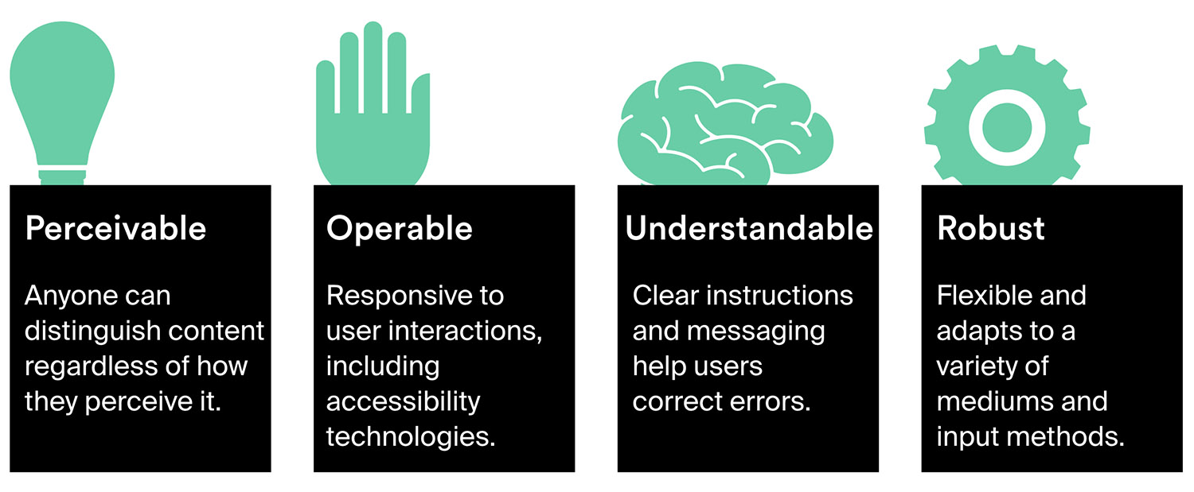
Accessibility Principles

Slide 14
Accessibility for Web Application
Content Developer
Designer
Tester
Code Developer

Slide 15
Accessibility Guidelines for Content Developer
Guideline | Principles | Level Of Conformance | WCAG Version
1.1.1 Non-text Content | Perceivable | Level A | 2.0
1.2.1 Audio-only and Video-only (Prerecorded) | Perceivable | Level A | 2.0
1.2.2 Captions (Prerecorded) | Perceivable | Level A | 2.0
1.2.3 Audio Description or Media Alternative (Prerecorded) | Perceivable | Level A | 2.0
1.2.4 Captions (Live) | Perceivable | Level AA | 2.0
1.2.5 Audio Description (Prerecorded) | Perceivable | Level AA | 2.0
1.2.6 Sign Language (Prerecorded) | Perceivable | Level AAA | 2.0
1.2.7 Extended Audio Description (Prerecorded) | Perceivable | Level AAA | 2.0
1.2.8 Media Alternative (Prerecorded) | Perceivable | Level AAA | 2.0
1.2.9 Audio-only (Live) | Perceivable | Level AAA | 2.0
1.3.3 Sensory Characteristics | Perceivable | Level A | 2.0
1.4.5 Images of Text | Perceivable | Level AA | 2.0
2.4.2 Page Titled | Operable | Level A | 2.0
2.4.4 Link Purpose (In Context) | Operable | Level A | 2.0

Slide 16
Accessibility Guidelines for Content Developer
Guideline | Principles | Level Of Conformance | WCAG Version
2.4.6 Headings and Labels | Operable | Level AA | 2.0
2.4.10 Section Headings | Operable | Level AAA | 2.0
3.1.3 Unusual Words | Understandable | Level AAA | 2.0
3.1.4 Abbreviations | Understandable | Level AAA | 2.0
3.1.5 Reading Level | Understandable | Level AAA | 2.0
3.1.6 Pronunciation | Understandable | Level AAA | 2.0
3.3.2 Labels or Instructions | Understandable | Level A | 2.0
3.3.3 Error Suggestion | Understandable | Level AA | 2.0
4.1.3 Status Messages | Robust | Level AA | 2.1

Slide 17
Accessibility Guidelines for Designer
Guideline | Principles | Level Of Conformance | WCAG Version
1.1.1 Non-text Content | Perceivable | Level A | 2.0
1.2.1 Audio-only and Video-only (Prerecorded) | Perceivable | Level A | 2.0
1.2.2 Captions (Prerecorded) | Perceivable | Level A | 2.0
1.2.3 Audio Description or Media Alternative (Prerecorded) | Perceivable | Level A | 2.0
1.2.4 Captions (Live) | Perceivable | Level AA | 2.0
1.2.5 Audio Description (Prerecorded) | Perceivable | Level AA | 2.0
1.2.6 Sign Language (Prerecorded) | Perceivable | Level AAA | 2.0
1.2.7 Extended Audio Description (Prerecorded) | Perceivable | Level AAA | 2.0
1.2.8 Media Alternative (Prerecorded) | Perceivable | Level AAA | 2.0
1.2.9 Audio-only (Live) | Perceivable | Level AAA | 2.0
1.3.2 Meaningful Sequence | Perceivable | Level A | 2.0
1.3.4 Orientation | Perceivable | Level AA | 2.1
1.3.5 Identify Input Purpose | Perceivable | Level AA | 2.1
1.3.6 Identify Purpose | Perceivable | Level AAA | 2.1
1.4.1 Use of Color | Perceivable | Level A | 2.0
1.4.2 Audio Control | Perceivable | Level A | 2.0
1.4.3 Contrast (Minimum) | Perceivable | Level AA | 2.0
1.4.4 Resize text | Perceivable | Level AA | 2.0

Slide 18
Accessibility Guidelines for Designer
Guideline | Principles | Level Of Conformance | WCAG Version
1.4.5 Images of Text | Perceivable | Level AA | 2.0
1.4.6 Contrast (Enhanced) | Perceivable | Level AAA | 2.0
1.4.7 Low or No Background Audio | Perceivable | Level AAA | 2.0
1.4.8 Visual Presentation | Perceivable | Level AAA | 2.0
1.4.9 Images of Text (No Exception) | Perceivable | Level AAA | 2.0
1.4.11 Non-text Contrast | Perceivable | Level AA | 2.1
1.4.12 Text Spacing | Perceivable | Level AA | 2.1
1.4.13 Content on Hover or Focus | Perceivable | Level AA | 2.1
2.1.4 Character Key Shortcuts | Operable | Level A | 2.1
2.2.1 Timing Adjustable | Operable | Level A | 2.0
2.2.2 Pause, Stop, Hide | Operable | Level A | 2.0
2.2.3 No Timing | Operable | Level AAA | 2.0
2.2.4 Interruptions | Operable | Level AAA | 2.0
2.3.1 Three Flashes or Below Threshold | Operable | Level A | 2.0
2.3.2 Three Flashes | Operable | Level AAA | 2.0
2.3.3 Animation from Interactions | Operable | Level AAA | 2.1
2.4.1 Bypass Blocks | Operable | Level A | 2.0
2.4.2 Page Titled | Operable | Level A | 2.0
2.4.4 Link Purpose (In Context) | Operable | Level A | 2.0

Slide 19
Accessibility Guidelines for Designer
Guideline | Principles | Level Of Conformance | WCAG Version
2.4.5 Multiple Ways | Operable | Level AA | 2.0
2.4.6 Headings and Labels | Operable | Level AA | 2.0
2.4.8 Location | Operable | Level AAA | 2.0
2.4.9 Link Purpose (Link Only) | Operable | Level AAA | 2.0
2.4.10 Section Headings | Operable | Level AAA | 2.0
2.5.1 Pointer Gestures | Operable | Level A | 2.1
2.5.2 Pointer Cancellation | Operable | Level A | 2.1
2.5.4 Motion Actuation | Operable | Level A | 2.1
2.5.5 Target Size | Operable | Level AAA | 2.1
2.5.6 Concurrent Input Mechanisms | Operable | Level AAA | 2.1
3.1.3 Unusual Words | Understandable | Level AAA | 2.0
3.1.4 Abbreviations | Understandable | Level AAA | 2.0
3.2.1 On Focus | Understandable | Level A | 2.0
3.2.2 On Input | Understandable | Level A | 2.0
3.2.3 Consistent Navigation | Understandable | Level AA | 2.0
3.2.4 Consistent Identification | Understandable | Level AA | 2.0
3.2.5 Change on Request | Understandable | Level AAA | 2.0

Slide 20
Accessibility Guidelines for Designer
Guideline | Principles | Level Of Conformance | WCAG Version
3.3.1 Error Identification | Understandable | Level A | 2.0
3.3.2 Labels or Instructions | Understandable | Level A | 2.0
3.3.3 Error Suggestion | Understandable | Level AA | 2.0
3.3.4 Error Prevention (Legal, Financial, Data) | Understandable | Level AA | 2.0
3.3.5 Help | Understandable | Level AAA | 2.0
3.3.6 Error Prevention (All) | Understandable | Level AAA | 2.0

Slide 21
Accessibility Guidelines for Code Developer and Tester
Guideline | Principles |  | Level Of Conformance | WCAG Version
1.1.1 Non-text Content | Perceivable |  | Level A | 2.0
1.2.1 Audio-only and Video-only (Prerecorded) | Perceivable |  | Level A | 2.0
1.2.2 Captions (Prerecorded) | Perceivable |  | Level A | 2.0
1.2.3 Audio Description or Media Alternative (Prerecorded) | Perceivable |  | Level A | 2.0
1.2.4 Captions (Live) | Perceivable |  | Level AA | 2.0
1.2.5 Audio Description (Prerecorded) | Perceivable |  | Level AA | 2.0
1.2.6 Sign Language (Prerecorded) | Perceivable |  | Level AAA | 2.0
1.2.7 Extended Audio Description (Prerecorded) | Perceivable |  | Level AAA | 2.0
1.2.8 Media Alternative (Prerecorded) | Perceivable |  | Level AAA | 2.0
1.2.9 Audio-only (Live) | Perceivable |  | Level AAA | 2.0
1.3.1 Info and Relationships | Perceivable |  | Level A | 2.0
1.3.2 Meaningful Sequence | Perceivable |  | Level A | 2.0
1.3.3 Sensory Characteristics | Perceivable |  | Level A | 2.0
1.3.4 Orientation | Perceivable |  | Level AA | 2.1
1.3.5 Identify Input Purpose | Perceivable |  | Level AA | 2.1
1.3.6 Identify Purpose | Perceivable |  | Level AAA | 2.1
1.4.1 Use of Color | Perceivable |  | Level A | 2.0
1.4.2 Audio Control | Perceivable |  | Level A | 2.0
1.4.3 Contrast (Minimum) | Perceivable |  | Level AA | 2.0

Slide 22
Accessibility Guidelines for Code Developer and Tester
Guideline | Principles | Level Of Conformance | WCAG Version
1.4.4 Resize text | Perceivable | Level AA | 2.0
1.4.5 Images of Text | Perceivable | Level AA | 2.0
1.4.6 Contrast (Enhanced) | Perceivable | Level AAA | 2.0
1.4.7 Low or No Background Audio | Perceivable | Level AAA | 2.0
1.4.8 Visual Presentation | Perceivable | Level AAA | 2.0
1.4.9 Images of Text (No Exception) | Perceivable | Level AAA | 2.0
1.4.10 Reflow | Perceivable | Level AA | 2.1
1.4.11 Non-text Contrast | Perceivable | Level AA | 2.1
1.4.12 Text Spacing | Perceivable | Level AA | 2.1
1.4.13 Content on Hover or Focus | Perceivable | Level AA | 2.1
2.1.1 Keyboard | Operable | Level A | 2.0
2.1.2 No Keyboard Trap | Operable | Level A | 2.0
2.1.3 Keyboard (No Exception) | Operable | Level AAA | 2.0
2.1.4 Character Key Shortcuts | Operable | Level A | 2.1
2.2.1 Timing Adjustable | Operable | Level A | 2.0
2.2.2 Pause, Stop, Hide | Operable | Level A | 2.0
2.2.3 No Timing | Operable | Level AAA | 2.0
2.2.4 Interruptions | Operable | Level AAA | 2.0
2.2.5 Re-authenticating | Operable | Level AAA | 2.0

Slide 23
Accessibility Guidelines for Code Developer and Tester
Guideline | Principles | Level Of Conformance | WCAG Version
2.2.6 Timeouts | Operable | Level AAA | 2.1
2.3.1 Three Flashes or Below Threshold | Operable | Level A | 2.0
2.3.2 Three Flashes | Operable | Level AAA | 2.0
2.3.3 Animation from Interactions | Operable | Level AAA | 2.1
2.4.1 Bypass Blocks | Operable | Level A | 2.0
2.4.2 Page Titled | Operable | Level A | 2.0
2.4.3 Focus Order | Operable | Level A | 2.0
2.4.4 Link Purpose (In Context) | Operable | Level A | 2.0
2.4.5 Multiple Ways | Operable | Level AA | 2.0
2.4.6 Headings and Labels | Operable | Level AA | 2.0
2.4.7 Focus Visible | Operable | Level AA | 2.0
2.4.8 Location | Operable | Level AAA | 2.0
2.4.9 Link Purpose (Link Only) | Operable | Level AAA | 2.0
2.4.10 Section Headings | Operable | Level AAA | 2.0
2.5.1 Pointer Gestures | Operable | Level A | 2.1
2.5.2 Pointer Cancellation | Operable | Level A | 2.1
2.5.3 Label in Name | Operable | Level A | 2.1
2.5.4 Motion Actuation | Operable | Level A | 2.1
2.5.5 Target Size | Operable | Level AAA | 2.1
2.5.6 Concurrent Input Mechanisms | Operable | Level AAA | 2.1

Slide 24
Accessibility Guidelines for Code Developer and Tester
Guideline | Principles | Level Of Conformance | WCAG Version
3.1.1 Language of Page | Understandable | Level A | 2.0
3.1.2 Language of Parts | Understandable | Level AA | 2.0
3.1.3 Unusual Words | Understandable | Level AAA | 2.0
3.1.4 Abbreviations | Understandable | Level AAA | 2.0
3.1.5 Reading Level | Understandable | Level AAA | 2.0
3.1.6 Pronunciation | Understandable | Level AAA | 2.0
3.2.1 On Focus | Understandable | Level A | 2.0
3.2.2 On Input | Understandable | Level A | 2.0
3.2.3 Consistent Navigation | Understandable | Level AA | 2.0
3.2.4 Consistent Identification | Understandable | Level AA | 2.0
3.2.5 Change on Request | Understandable | Level AAA | 2.0
3.3.1 Error Identification | Understandable | Level A | 2.0
3.3.2 Labels or Instructions | Understandable | Level A | 2.0
3.3.3 Error Suggestion | Understandable | Level AA | 2.0
3.3.4 Error Prevention (Legal, Financial, Data) | Understandable | Level AA | 2.0
3.3.5 Help | Understandable | Level AAA | 2.0
3.3.6 Error Prevention (All) | Understandable | Level AAA | 2.0
4.1.1 Parsing | Robust | Level A | 2.0
4.1.2 Name, Role, Value | Robust | Level A | 2.0
4.1.3 Status Messages | Robust | Level AA | 2.1

Slide 25
References
https://en.wikipedia.org/wiki/Accessibility
https://www.google.com/image
https://www.who.int/disabilities/world_report/2011/report/en/
https://en.wikipedia.org/wiki/Assistive_technology
https://www.w3.org/WAI/EO/Drafts/bcase/resources
https://www.w3.org/WAI/

Slide 26
Thank You!
For any queries connect me at jatinkochhar@hotmail.com

